Slide 1
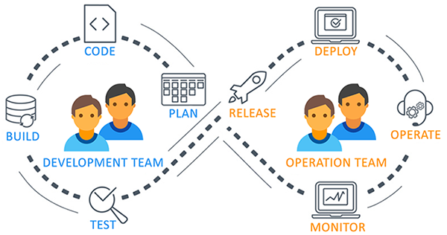
Azure DevOps
Azure DevOps is a set of development tools and services provided by Microsoft to support the entire software development lifecycle.
It enables teams to plan work, collaborate on code development, and build and deploy applications efficiently.
Azure DevOps, a modern DevOps tool of planning, developing, testing and deploying modern apps.
Azure DevOps services are independent of cloud or platform.

Slide 2
Azure DevOps Services Vs. Server
Azure DevOps comes with two options:
Azure DevOps Services
Azure DevOps Server
Both the services and the server were known as Visual Studio Team Services (VSTS) and Team Foundation Server (TFS), respectively. They provide environments that support Git, Agile tools, and continuous integration. Let us see the differences between them:
Azure DevOps Services | Azure DevOps Server
It is a cloud offering. | It is an on-premise offering.
It offers two options for scaling and scoping data: organizations and projects. | It offers three options for scaling and scoping data: deployment, project collections, and projects.
You can connect over the public network. | You can connect to the intranet server.
The access level must be assigned to each user. | Access levels must be set based on the license.

Slide 3
Azure DevOps Benefits
Fully integrated with GitHub, Visual Studio, and other tools.
Cloud-based and scalable, but also available on-premises as Azure DevOps Server.
Promotes collaboration, automation, and agile workflows.
End-to-end toolchain for DevOps.

Slide 4
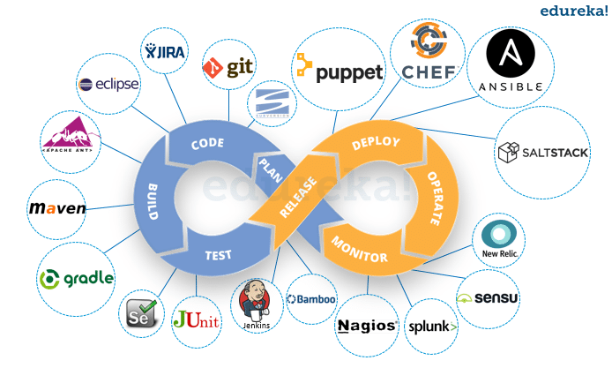
Tools for Azure DevOps
Azure DevOps works well with most of the DevOps tools.
Category | Tools Name
Configuration Tools | Chef, Ansible, Puppet
Continuous Integration | Jenkins
Microservices | Docker
Collaboration | Slack, Trello
Monitoring | Kibana, Grafana
Development | Visual Studio

Slide 5
Use Cases
Automating builds and deployments with pipelines.
Managing agile development with sprints and boards.
Performing code reviews and branching strategies.
Hosting and managing project repositories.

Slide 6
Why Choose Azure DevOps?
Azure DevOps stands out as a comprehensive and flexible platform for modern software development teams.
Here are the key reasons why organizations choose Azure DevOps:
🌐 1. All-in-One DevOps Platform
Azure DevOps offers a complete toolchain for software development and delivery:
Planning (Azure Boards)
Development (Azure Repos)
Testing (Azure Test Plans)
Delivery (Azure Pipelines)
Package Management (Azure Artifacts)
This reduces the need to integrate and manage multiple third-party tools.
🔁 2. Supports Any Language, Platform, or Cloud
Works with .NET, Java, Node.js, Python, and more.
Supports building and deploying to Windows, Linux, or macOS.
Compatible with Azure, AWS, GCP, or on-premises environments.

Slide 7
Why Choose Azure DevOps?
⚙️ 3. Strong Integration and Extensibility
Integrates with tools like GitHub, Slack, Docker, Kubernetes, Jenkins, etc.
Over 1000 extensions available in the Azure DevOps Marketplace.
📊 4. Enterprise-Ready
Backed by Microsoft’s cloud infrastructure for scalability and security.
Suitable for small teams to large enterprises.
🚀 5. Agile and DevOps Practices Out-of-the-Box
First-class support for Agile, Scrum, and Kanban methodologies.
Built-in CI/CD pipelines for automating the software lifecycle.
Encourages a culture of collaboration and continuous improvement.
💰 6. Cost-Effective and Flexible Pricing
Free tier for small teams (up to 5 users).
Pay-as-you-go model for larger teams.

Slide 8
Key Services/Components in Azure DevOps
Azure DevOps is made up of five core services, each addressing a specific part of the software development lifecycle. These components can be used together or individually, depending on your team's needs.
Azure Repos
Azure Pipelines
Azure Boards
Azure Test Plans
Azure Artifacts

Slide 9
Key Services/Components in Azure DevOps
1. Azure Boards
Purpose: Agile project management and work tracking.
Features:
Work items (user stories, bugs, tasks)
Kanban boards and Scrum support
Sprint planning and backlogs
Dashboards and reporting

Slide 10
Key Services/Components in Azure DevOps
2. Azure Repos
Purpose: Source code management.
Features:
Git repositories and Team Foundation Version Control (TFVC)
Pull requests and code reviews
Branching and merging strategies
Commit history and auditing

Slide 11
Key Services/Components in Azure DevOps
3. Azure Pipelines
Purpose: Continuous Integration (CI) and Continuous Delivery (CD).
Features:
Build automation and deployment workflows
Multi-platform support (Windows, Linux, macOS)
Container and Kubernetes support
YAML or classic editor pipelines
Integration with GitHub, Bitbucket, etc.

Slide 12
Key Services/Components in Azure DevOps
4. Azure Test Plans
Purpose: Manual and exploratory testing tools.
Features:
Test case management
Test execution and results tracking
Bug reporting directly from test runs
Rich data capture during testing sessions

Slide 13
Key Services/Components in Azure DevOps
4.Azure Artifacts
Purpose: Package management and distribution.
Features:
Host and share NuGet, npm, Maven, Python, and Universal packages
Integrates with CI/CD pipelines
Controls over versioning and access
Rich data capture during testing sessions
Bonus: Extensions and Integrations
Azure DevOps integrates with a wide range of tools and has a marketplace for adding features such as Slack notifications, SonarCloud analysis, and more.

Slide 14
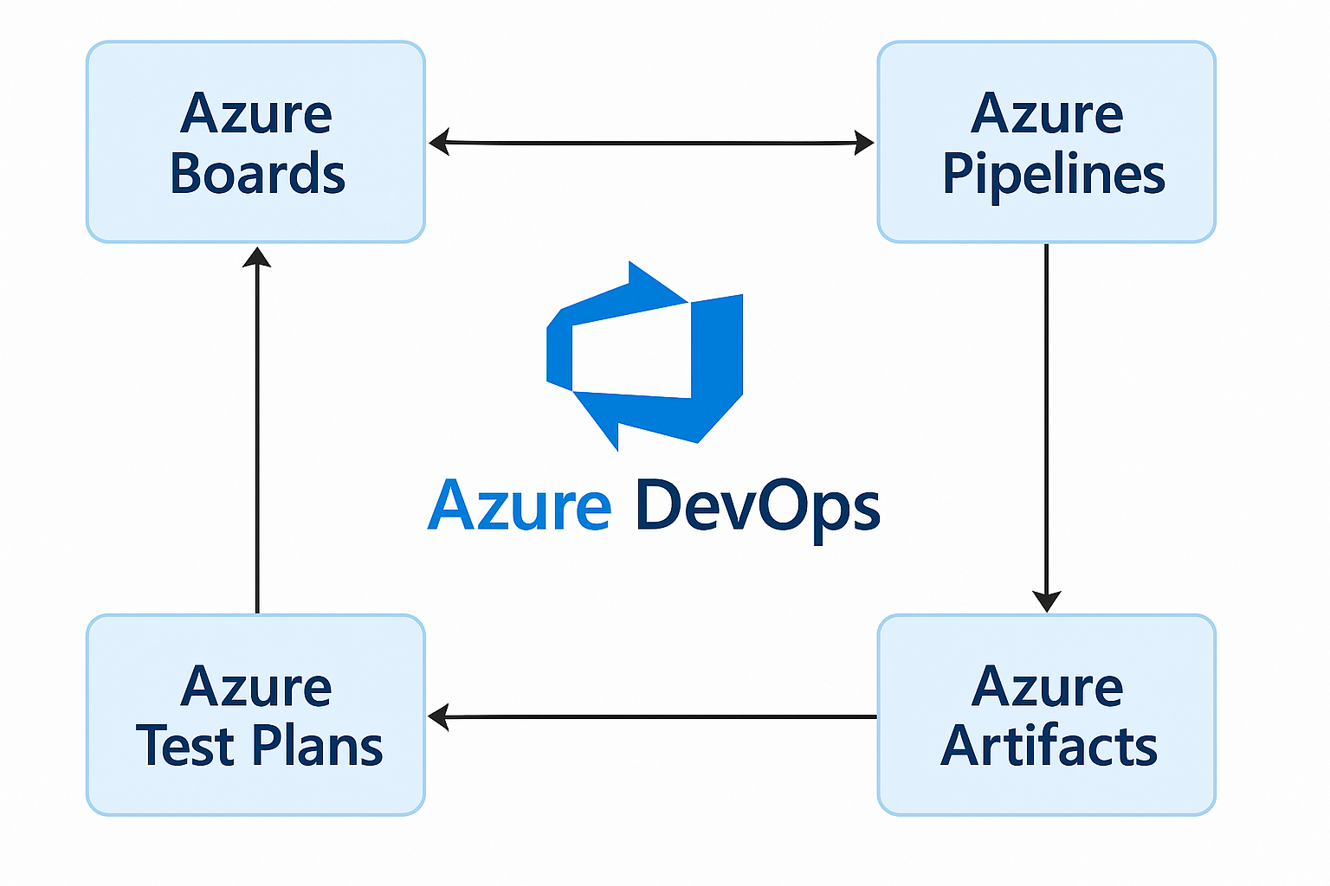
Key Services/Components in Azure DevOps

